Slide 1
Chinese Cultural Tour 中国文化之旅
Di Luo, Amanda Jensen
Digital Humanities 402, Spring 2015

Slide 2
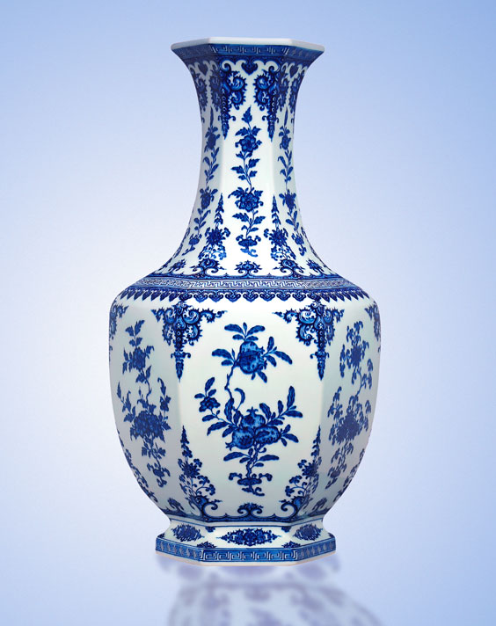
Purpose of the Site
Educate a general Western audience regarding Chinese culture
Highlights of basic Chinese tour locations
Display cultural overview including music, documentary, maps, and text.

Slide 3
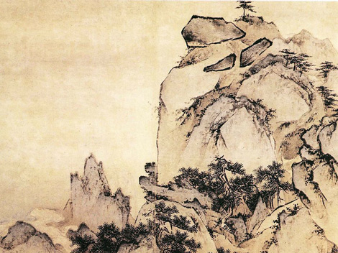
General Site Overview
Home Page regarding China and its location in connection with its neighboring countries
Menu bar at top with information:
Follows 402 framework pattern
Home (Navigates to basic start page)
About (Gives introduction to site)
Contact (Includes email information for creators in case of questions)
Help (Basic Help page)
Site Content (Links to menus on the left.)

Slide 4

Menu Bar
Map of China with highlighted tour sites
Gallery of Chinese Tour Locations including pictures
Books - Textual Introduction of famous tour sites
Audio Gallery
Video Gallery
Collection – All contents in China Tour

Slide 5
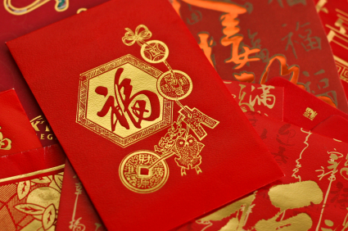
Plug-Ins
Google Fusion Table with Map
Audio Plug-Ins: Audio Forward
Video Plug-Ins: Video Control, Video Mute
Google Maps Plug-In

Slide 6
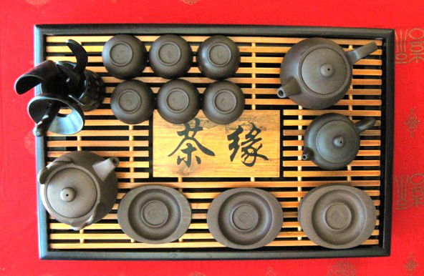
Group Files
Book style
Gallery (Images)
Text
Video Gallery (3 BBC documentary clips “Wild China”)
Audio Gallery (traditional Chinese music)

Slide 7

Frame Views
Atlas
Audio
Book
Content
Gallery
Image html builder
Map
Search
Taxonomy
Text
Video
Video Gallery
Audio Gallery

Slide 8
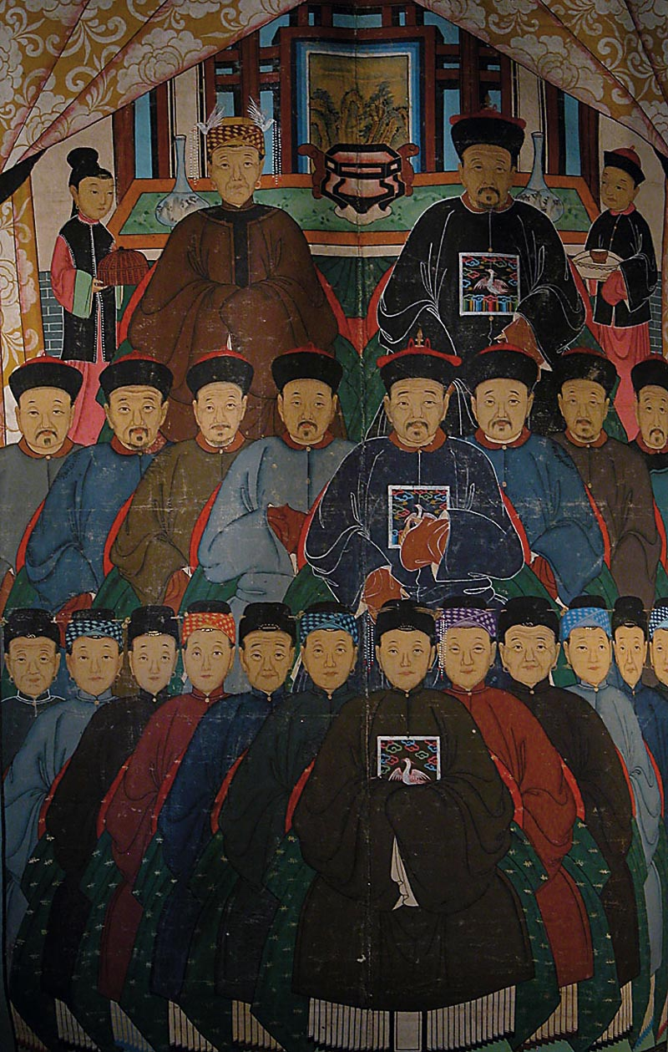
Taxonomy
Different types of taxonomy to group various data formats together (e.g. Images Gallery, Audio Gallery, Video Gallery, and etc.)

Slide 9

Content Lookup
Search Table by content ID
Example:
individual item: ?node=content/text&id=1
taxonomy: ?node=content/image/gallery&id=3
3 groups for 3 tour stops (sites); 4 groups for 4 sites
Corresponding taxonomy of adding more information to grouping based on tour stop site

Slide 10
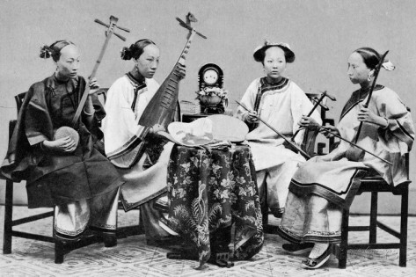
Content_Meta Sources
Music (audio file clips)
Wild China (BBC documentary clips)
All image files
Maps

Slide 11
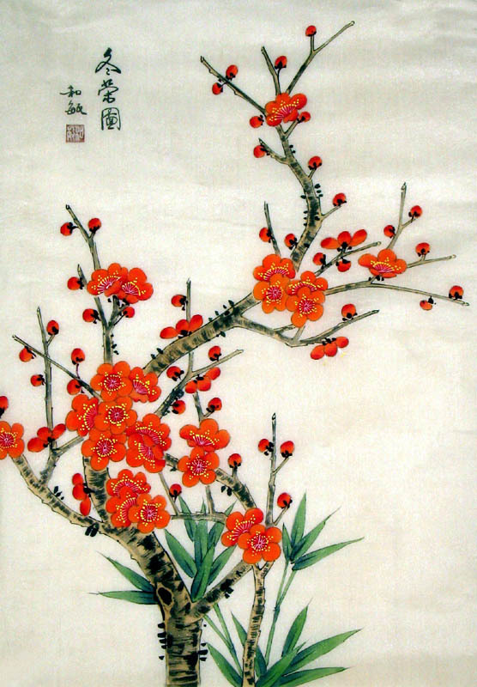
Node Links
All side bar items (grouped together)

Slide 12

HDI Concepts
Chose red with yellow lettering out of cultural respect for China
Although it does not fit with color-blind schema, the colors fit with the cultural schema. In this case, the cultural schema is more important.
Icon at top left navigates back to the home screen and includes a popular Chinese zodiac character, the horse. The horse may already be familiar with some me

Slide 13
Site Demonstration

Slide 14
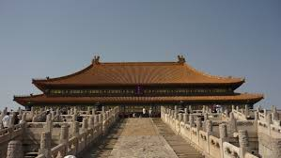
Any Questions?

Slide 15
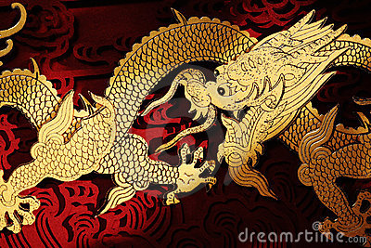
The End

